Slide 1
Iterative Reweighted Least Squares
Authors: Hubert Ruczyński, Adrian Stańdo
16th April 2023
Notes:
Good morning, I’m Hubert Ruczyński and in this video I’ll present the outcomes of the project concerning the implementation of the Iterative Reweighted Least Squares algorithm, which we’ve implemented with Adrian Stańdo, during the Advanced Machine Learning classes.

Slide 2
01
Introduction
Notes:
Without further adue, let’s start with the Introduction.

Slide 3
Project description
Main goal:
Implementation of the Iterative Reweighted Least Squares (IRLS) optimisation algorithm for parameter estimation in Logistic Regression.
Including the interactions to the IRLS algorithm.
Evaluation:
Development of the methodology that tests the correctness of implementation.
Comparison to existing solutions on real-life datasets.
Notes:
The aim of the project was to implement Iterative Reweighted Least Squares (IRLS) optimisation algorithm for parameter estimation in Logistic Regression (LR).
Moreover, the implementation includes an additional functionality based on the possibility of adding interactions between two variables.
The outcomes testing the correctness of implementation are evaluated with experiments conducted on artifficial,
And real-life data.

Slide 4
02
Implementation
Notes:
Firstly, let’s sum up the project umplementation.

Slide 5

Project R package
1. The solution is implemented in the form of R package.
2. Installation from GitHub repository: https://github.com/HubertR21/DS23IterativeReweightedLeastSquares.
3. Source code with roxygen documentation in R directory.
4. Conducted experiments in the vignettes folder.
5. Included data sets in data directory.
6. Unit tests are included in the tests folder.
Notes:
The solution is implemented in the form of R package.
We can install it from the GitHub repository,
Source code with roxygen documentation is present in R directory.
Conducted experiments in the vignettes folder.
Included data sets in data directory.
And Unit tests are included in the tests folder.

Slide 6
03
Simulated datasets experiments
Notes:
Now, let’s get into the artificial data experiments.

Slide 7
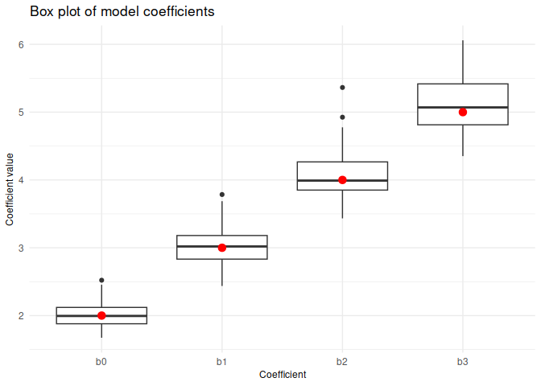
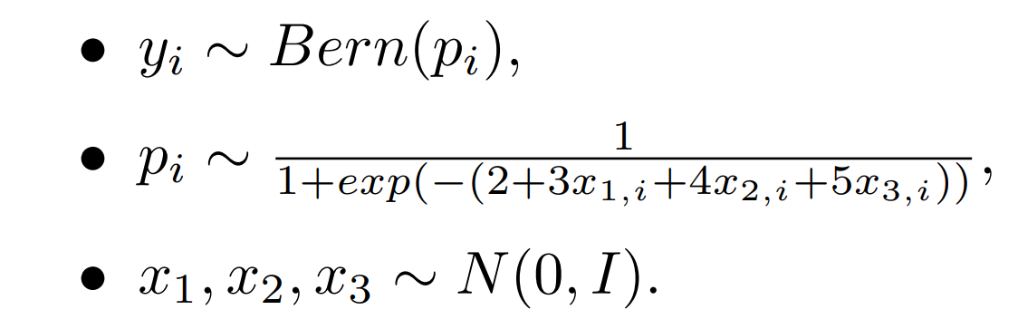
Experiment 1: coefficients estimation
Notes:
In the first scenario, the three-dimensional training data points were generated from the normal standard distribution, and the target vector was generated from the Bernoulli distribution with parameter p calculated according to the logistic model. This experiment was repeated 50 times - each time a new dataset was generated, a model was fitted and the model coefficients were extracted. Afterwards, the box plot of the values was created.
It can be observed that the median values marked on the box plots correspond to the theoretical values of the coefficients, so the methods works properly.

Slide 8
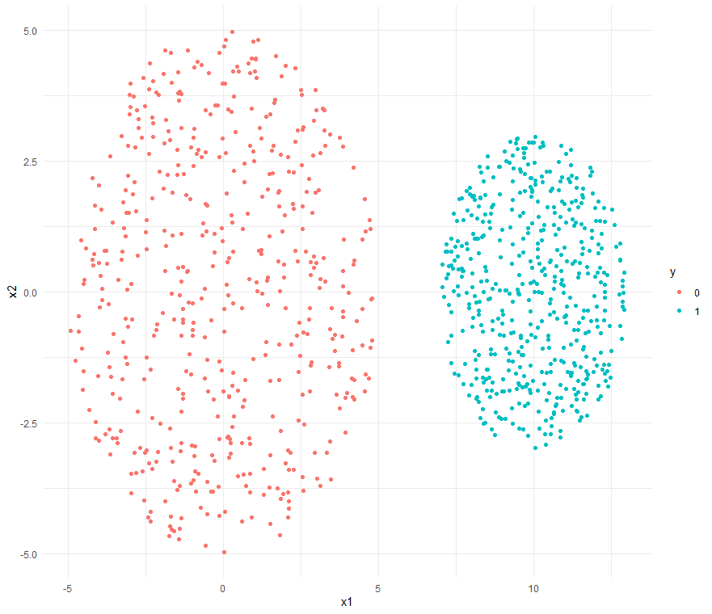
Experiment 2: linear separability
The experiment was repeated 50
times and the method has never
converged.
Notes:
In this scenario, the training data points were generated uniformly from two non-overlapping circles (the first one was with the centre in S = (0, 0) and radius R = 5; the second one was with the centre in S = (10, 0) and radius R = 3). One well-known property of the LR model is that it cannot handle linearly separable classes. The aim of this experiment was to check whether this property also holds for this implementation.
This experiment was repeated 50 times. And the results show that the algorithm did not converge in 100% cases.

Slide 9
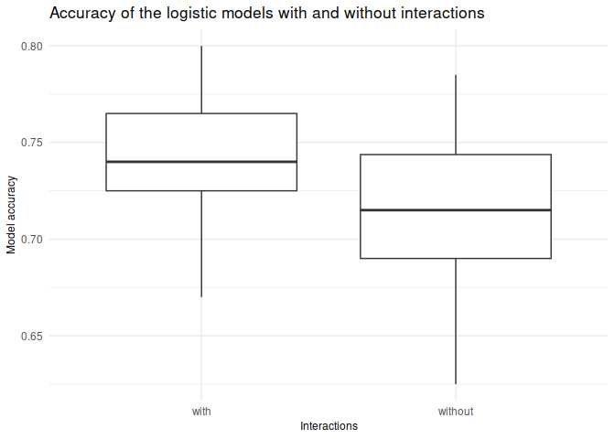
Experiment 3: Interactions
The inspiration for this experiment came from observing nature: plants grow when they have access to water and sunlight. If either of them is missing, plants do not have the right environmental conditions to grow.
Notes:
The inspiration for this experiment came from observing nature: plants grow when they have access to water and sunlight. If either of them is missing, plants do not have the right environmental conditions to grow. The dataset is designed to reflect this situation. If the plant has high water and sunlight values, it will most likely live. If it lacks one or both of them it will most likely die.
This experiment was also repeated 50 times. Each time two models were trained: with and without interactions, and the accuracy scores were compared. It is clear from the chart that the addition of interactions to the models did improve their performance.

Slide 10
04
Real-life datasets experiments
Notes:
But how does our solution work on the real-life datasets?

Slide 11
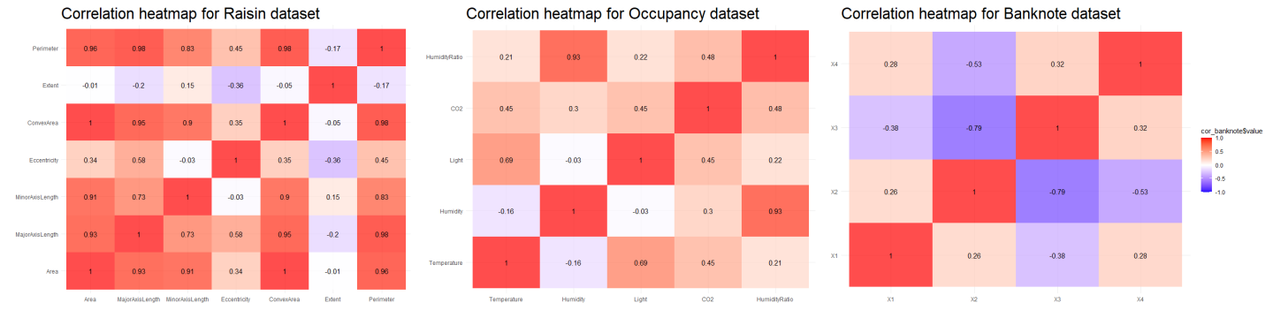
Methodology
1. Three datasets: raisin, occupancy, banknote.
2. Removal of higly correlated columns (r rank > 0.7).
Notes:
We’ve tested our implementation on three UCI datasets: raisin, occupancym and the bankonte
The only preprocessing step in these experiments was the removal of highly correlated columns (r rank > 0.7).
Thanks to that, we have greatly diminished

Slide 12
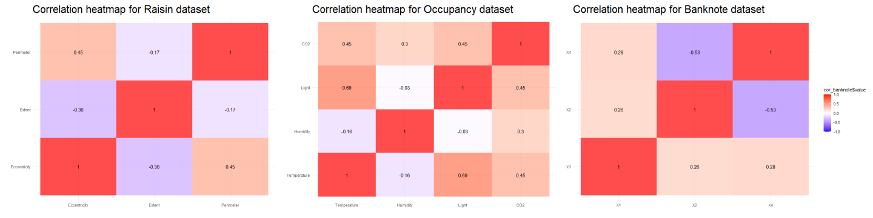
Methodology
1. Three datasets: raisin, occupancy, banknote.
2. Removal of higly correlated columns (r rank > 0.7).
Notes:
the \textit{raisin} dataset to just three out of seven variables, the \textit{occupancy} dataset remained as it was, whereas from the \textit{banknote} we removed \textit{X3} feature.

Slide 13
Methodology
1. Three datasets: raisin, occupancy, banknote.
2. Removal of higly correlated columns (r rank > 0.7).
3. Comparison to other Machine Learning algorithms: KNN, LDA, QDA, and available implementation of the IRLS in R.
Notes:
Afterwards, the implemented IRLS algorithm for Logistic Regression is compared with other Machine Learning algorithms: K-nearest neighbours, Linear Discriminant Analysis, Quadratic Discriminant Analysis and another (publicly available) implementation of IRLS in R. Moreover, we also consider our implementation with interactions of the most correlated features that weren’t removed.
Now, let’s get to the outcomes

Slide 14
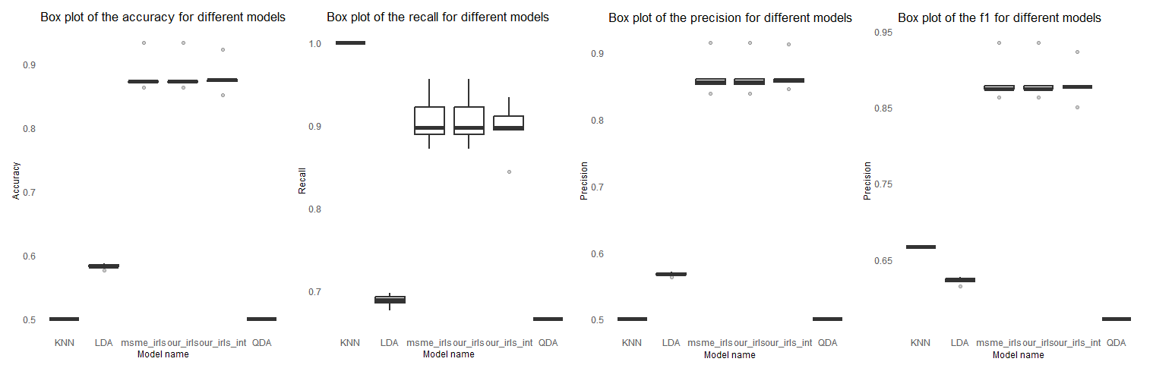
Results: raisin
Notes:
Let’s notice that the plots are quite similar for all data sets.

Slide 15
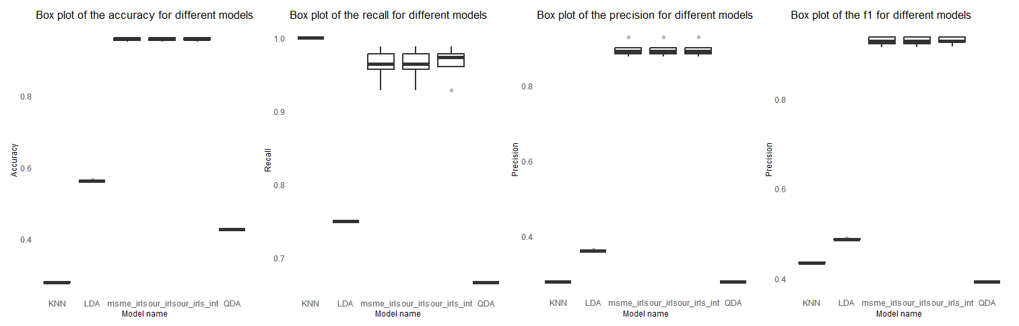
Results: occupancy
Notes:
In all the cases, KNN, QDA, and LDA algorithms perform quite poorly compared to all considered Logistic Regression implementations. However, it is worth noting that the KNN method achieved almost perfect recall in all cases.

Slide 16
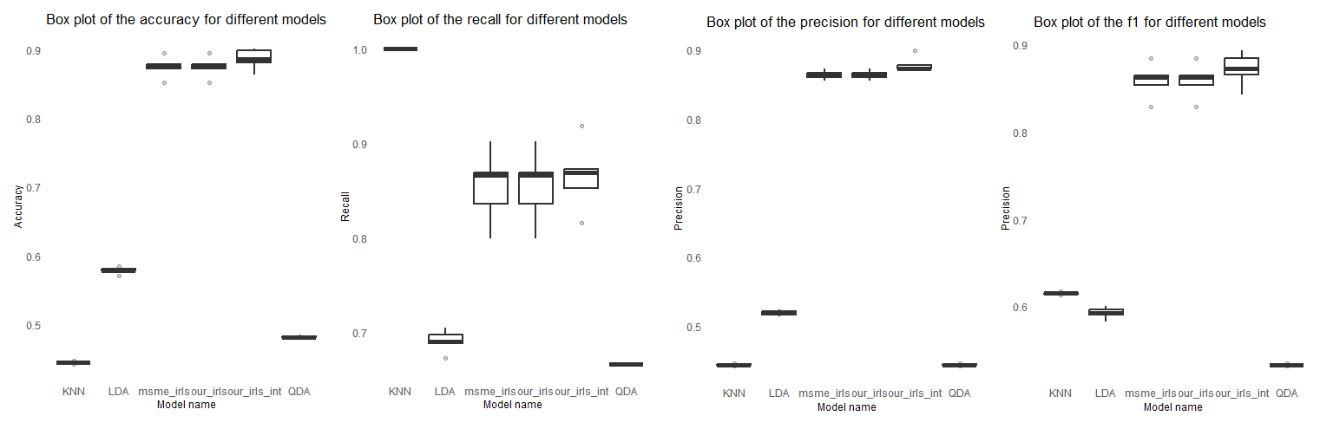
Results: banknote
Notes:
Another significant observation is that our IRLS implementation with interactions turned out to be a little bit or significantly better than other Linear Regression methods in case of the banknote data set. Finally, we can clearly say, that our implementation is similar or even better than the ones we’ve been comparing to.

Slide 17
05
Summary
Notes:
Now, let’s breifly sum up the presentation.

Slide 18
Summary
1. We’ve developed a package with the implementation of the IRLS algorithm.
2. Tested the correctness of our implementation on simulated datasets.
3. We’ve compared our method to other available LR solutions on real-life datasets.
4. During the project, we’ve gained a better insight into how the Logistic Regression method works.
Notes:
During the project, we managed to implement one of the methods to estimate Logistic Regression coefficients - IRLS.
We tested the correctness of our implementation on simulated datasets, and the results of the experiments were as expected.
Afterwards, we checked our algorithm by training models on real-life datasets and compared the achieved scores with other Machine Learning methods.
Finally, the Logistic Regression turned out to be quite a powerful method and, in terms of almost all considered metrics, it gave the best results. We believe that thanks to this project, we gained a better insight into how the Logistic Regression method works.

Slide 19
Thanks for your attention.
Notes:
Thanks for your attention.

